Slide 1
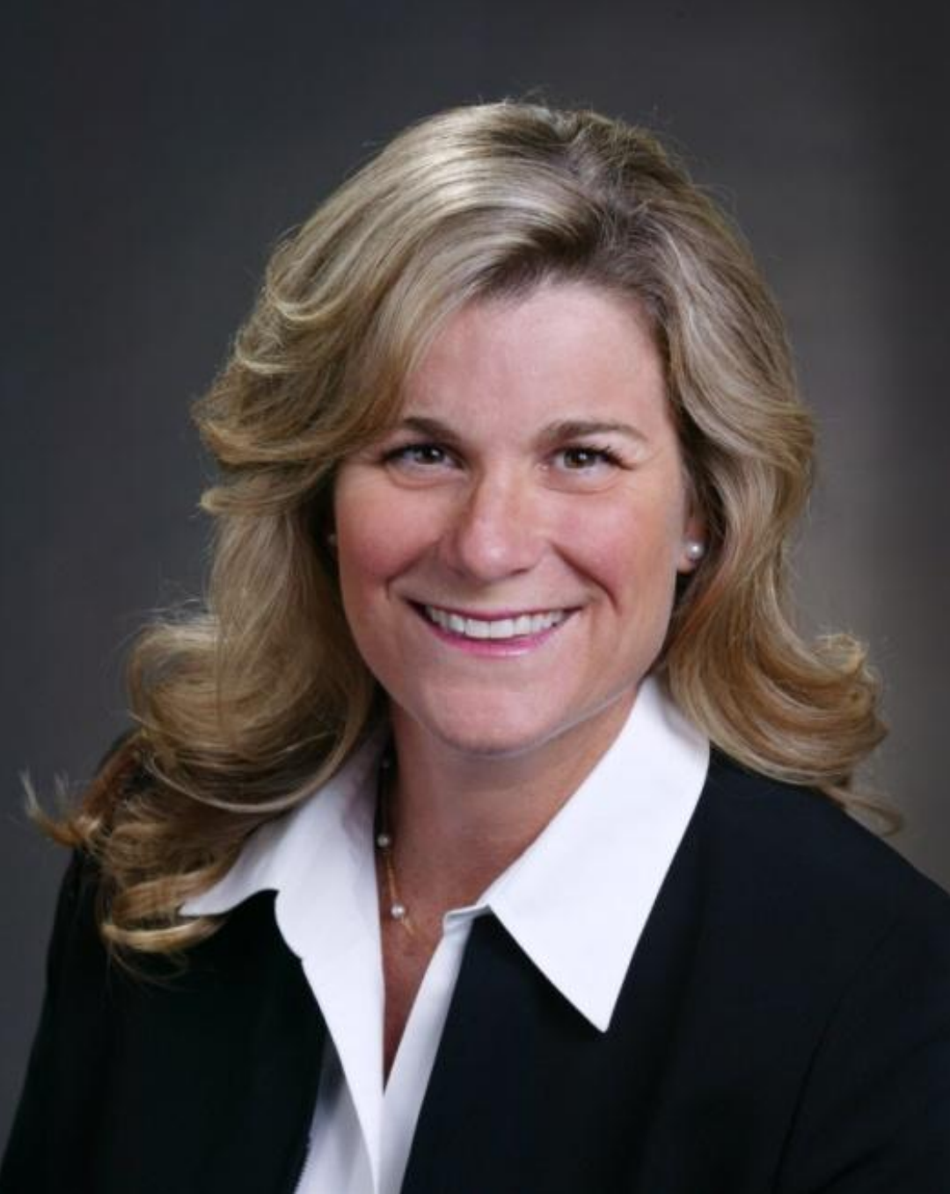
Carolyn Stone
2004-2005
Year of hurricanes Jeanne and Francis!
Check presented to South Florida Science Museum for $50,000 to fund the Early Learning Center at the Dekelbaum Science Center
Membership changes: Sustainer eligibility went from 10 to 8 years of service min.; Actives- removed 39 and Holding as the max. age; New Members (Provisionals)- removed the max. age threshold
Community service hours now tied to Years of Service tier, i.e. 10+ years = waived hours
Formation of the Communications Council
Quantum House voted to sunset; it was deemed self sufficient to warrant a full time JLPB committee which is a great thing! JLPB to continue to volunteer as DIAD or as needed

Slide 2
