Slide 1
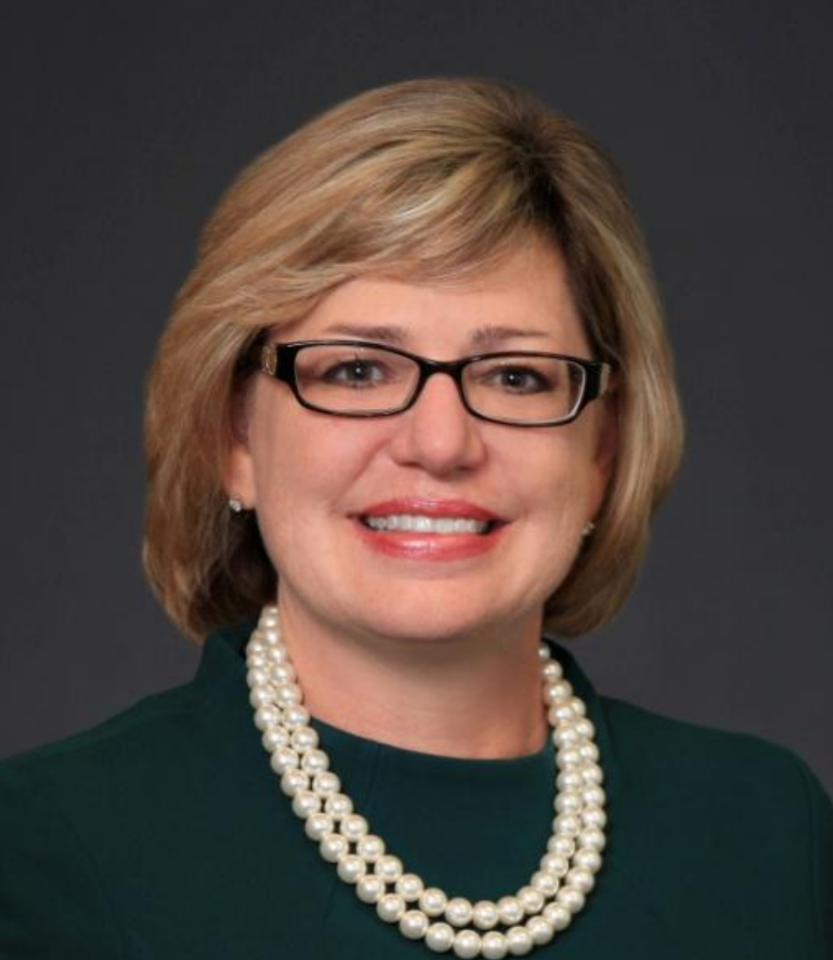
Kathy (Tignor) McHale
2000-2001
60th year of JLPB service to the community and WPB mayor declared March 27, 2001 Junior League of the Palm Beaches day!
Approved JLPB logo as it is today - palm tree surrounded by our name
We held our 1st Women's Health Symposium in partnership with Jupiter Medical Center to promote awareness of women’s health issues.
Raised $4,000 to start the first Endowment campaign
Created 15 hour volunteer commitment to further our mission of improving the community
Nelle Smith community program was approved- the rest is history
New Member class of 60 collaborated to raise awareness for breast cancer and lined Flagler Drive with pink ribbons raising over $10,000 for the Susan G. Komen Foundation
Quantum House opened in May, 2001. JLPB donated the jungle themed children's playroom

Slide 2
